Slide 1
Title: Regression Analysis of Startup Success Subtitle: Exploring Multiple Regression Techniques
Your Name: Dhilipan L Date: Sep-2024

Slide 2
Introduction
Objective: To analyze factors influencing the success of startups using various regression models.
Dataset: 50 Startups dataset containing features such as R&D Spend, Administration Spend, Marketing Spend, and State.
Goal: Determine the best predictive model for startup success.

Slide 3

Data Preprocessing
Data Loading: Imported necessary libraries and loaded the dataset.
Feature Selection:
Independent Variables: R&D Spend, Administration Spend, Marketing Spend, State.
Dependent Variable: Profit.
Train-Test Split: 80% training and 20% testing data.

Slide 4
Regression Techniques
Models Used:
Linear Regression
Ridge Regression
Lasso Regression
Polynomial Regression (Degree 2)
Support Vector Regression (SVR)
Decision Tree Regression
Random Forest Regression
Gradient Boosting Regression
Quantile Regression (50th percentile)
Evaluation Metrics: RMSE and R² Score for model performance.

Slide 5
Summary of Results
Model | RMSE | R² Score
linear Regression | 7805.76 | 0.9164
Ridge Regression | 7810.91 | 0.9163
Polynomial Regression (Deg 2) | 4581.65 | 0.9735
Lasso Regression | 7780.67 | 0.9171
Support Vector Regression | 7589.27 | 0.9221
Decision Tree Regression | 8203.92 | 0.9074
Random Forest Regression | 3582.72 | 0.9853
Gradient Boosting Regression | 4978.13 | 0.9673
Quantile Regression | 8102.83 | 0.9105

Slide 6
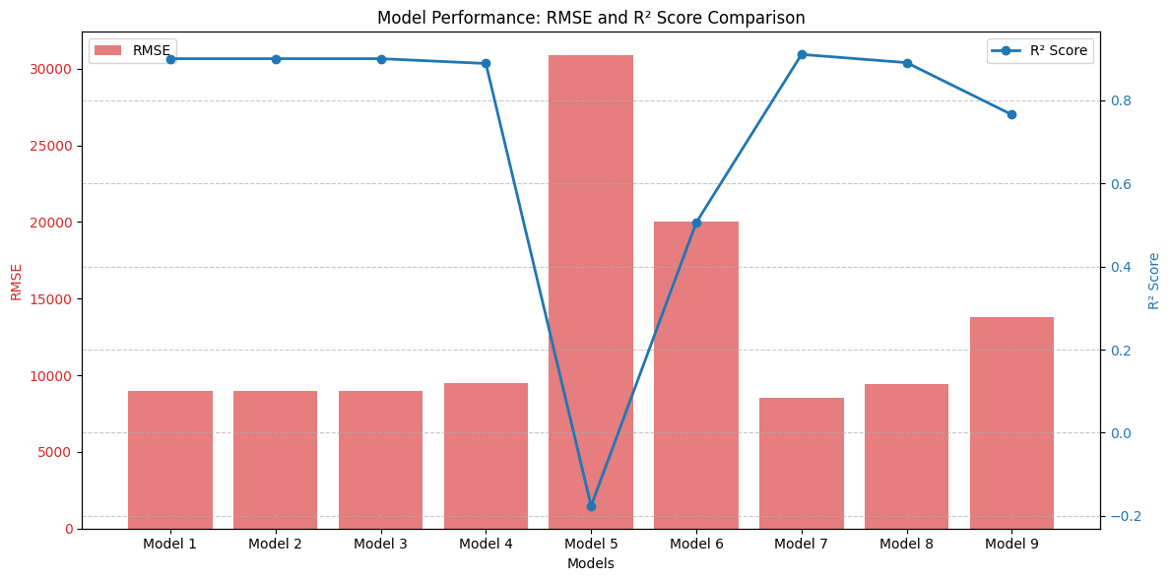
Summary of Results
Best Performing Models: This comparison shows that Random Forest Regression outperformed all other models both in terms of minimizing the RMSE and maximizing the R² Score, making it the best-performing model.
Best Performing Models
Best Model Based on RMSE: Random Forest Regression with RMSE of 3582.72
Best Model Based on R² Score: Random Forest Regression with R² Score of 0.9853

Slide 7
Conclusion & Future Work
70%
60%
50%
40%
Future Work:
Explore additional models (e.g., Neural Networks).
Performhyperparameter tuning for further optimization.
Investigate deeper featureengineering.
Conclusion:
Random Forest Regression outperformed other models.
R&D Spend and Marketing Spend were significant in predicting startup profits.

Slide 8
Thanks

